Slide 1
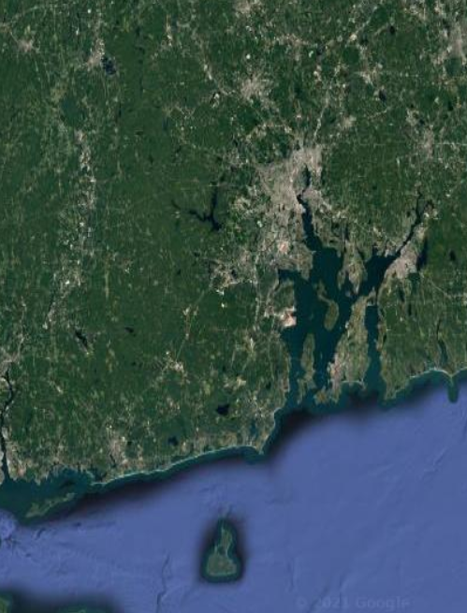
The State Guide Plan: Rhode Island’s Big-Picture Policy Guide for Agencies and Municipalities
Presented to the Special Legislative Commission to Study the Low and Moderate Income Housing Act
Meredith E. Brady,
Associate Director,
Division of Statewide Planning
(the State’s Unified Planning Agency & Single MPO)
April 26, 2022

Slide 2
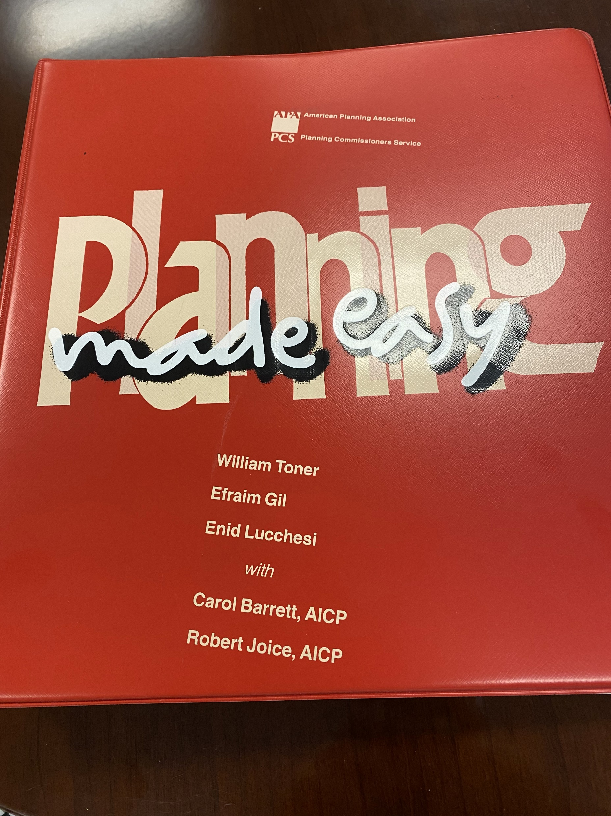

Slide 3
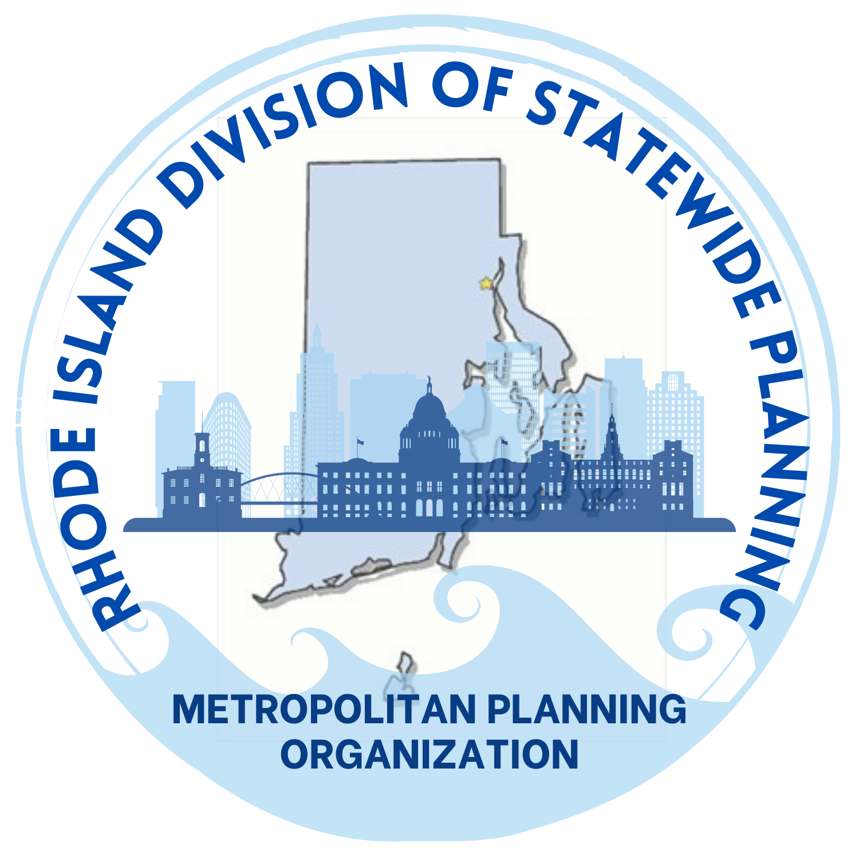
I’ll Tell You About
1) The Division of Statewide Planning
2) The State Guide Plan
3) Local Comprehensive Planning (and the State’s Role)
4) Land Use 2025
a) Where We Were
b) What We Knew
c) What’s Changing
Objective: inform future discussion about land use and subdivision statutes and local regulation, tools to help implement local goals and objectives.

Slide 4
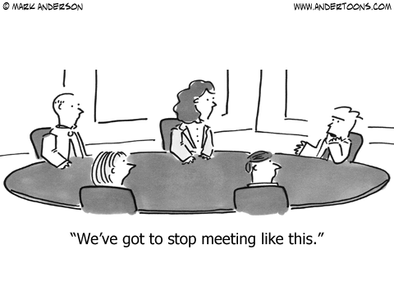
Division of Statewide Planning
The Statewide Planning Program consists of the State Planning Council, and the Division of Statewide Planning, a division within the Department of Administration.
The State Planning Council (27 members) is comprised of federal, state, local, public representatives, and other advisors, and guides the work of the Program.
The Division of Statewide Planning is the staff agency of the State Planning Council.

Slide 5
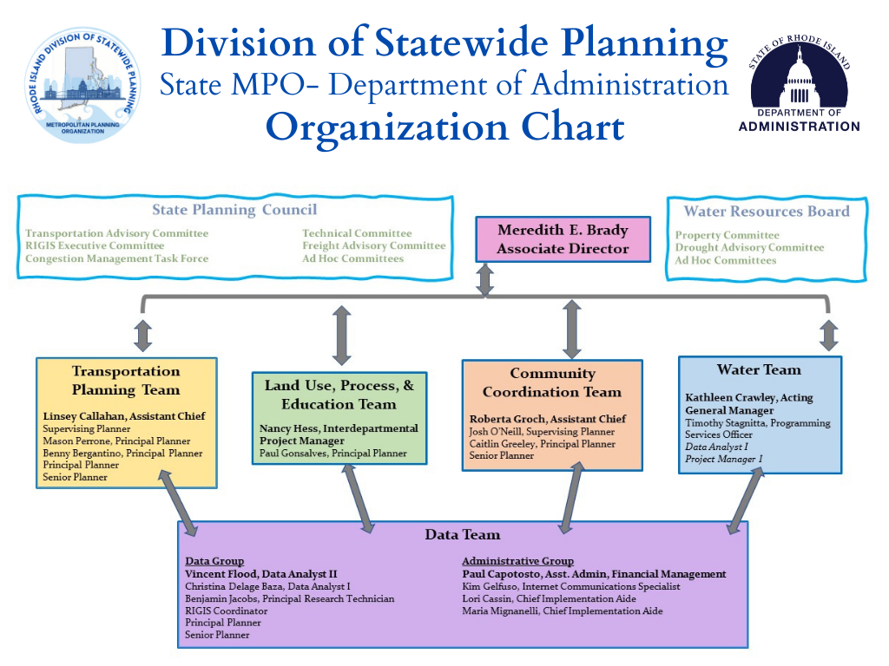

Slide 6
Planning for Rhode Island’s
physical, economic, and social development since 1964
The Division of Statewide Planning
Central state planning agency established by
R.I. General Law 42-11
Coordinate the activities of government agencies, communities, & organizations through the State Guide Plan
Provide planning assistance to the Governor, the General Assembly, municipalities, and other state agencies
Review local comprehensive plans, proposed projects, and activities for consistency with the State Guide Plan
Metropolitan Planning Organization (MPO) for federal transportation planning and funding

Slide 7
Division of Statewide Planning Mission Statement
  The Division of Statewide Planning promotes and encourages
  best practices for the balanced growth and development of the
  State of Rhode Island. We do so by:
    • Connecting agencies, communities, and organizations;
    • Guiding land use, water, and transportation choices; and
    • Promoting continuous, cooperative, and comprehensive
    application of planning principles, along with data-driven
    analysis, to create and implement State, regional, and
    local plans.
  Our goal is to ensure equitable, sustainable, and resilient
  development that meets the needs of the present without
  compromising the needs of the future

Slide 8
Fitting the Pieces Together
10,000 Foot View
A Closer Look
Measurable Steps
State Guide Plan Elements
Local Comprehensive Plans
Goals and Objectives
Long-Range Plans
Implementation Plans/Programs
Short Term Goals/Objectives

Slide 9

Move to the Foundry (accessibility)
Long Range Transportation Plan
Bike & Pedestrian Mobility Plan
Congestion Management Plan
Transit Master Plan
Equity Benefit Analysis for the STIP & LRTP
State Freight Committee
Port of Providence Community Engagement
Small Business Resilience
I-95 Corridor Coalition (The Eastern Transportation Coalition) Training and Involvement
TRB & NCHRP Involvement
Regional MPO Outreach and Coordination
STIP adoption & 32 amendments (including 1 major and 4 minor)
Migration to an E-STIP and PMG STIP Manager Platform
Tri-Party Agreement
STIP MOU in Changing Times
Continuing Education of Decisionmakers and Committees
Training and Professional Development
FHWA Climate Change Webinars
Annual Obligation Report
Census Data and Census 2020
Update of Public Participation Plan & LEP
Contact Database Development
Continuous Development of Map Data and Map Products
Local Partnerships
Revolving Terms Re-Established
State Planning Council Membership Changes
Pivot to Virtual Public Meetings due to COVID

Slide 10

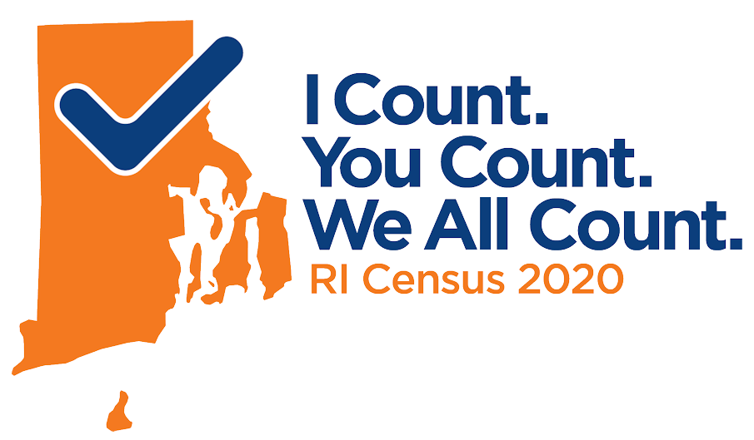
Census – State Complete Count Committee
Established by EO in December 2018
63 members, 7 subcommittees, 3 committees
Outreach – pre-COVID
Outreach – post-COVID
Changing Census dates

Slide 11




2020 Census Timeline
October 31, 2020
The Long and Winding Road
New 2020 Census End Date (Announced in May)
2020 Census Begins
July 31, 2020
And also end date required by Court Order
Late March 2020
Original 2020 Census End Date
And also Halloween
REVERSE COURSE! September 30, 2020 End Date
Rhode Island Census Complete Count Committee Established
COVID-19
August 2020
Governor’s Executive Order, December 2018
Postpones 2020 Census Field Operations
Census Field Work Begins
Announced in August

Slide 12
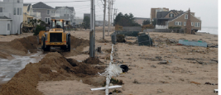
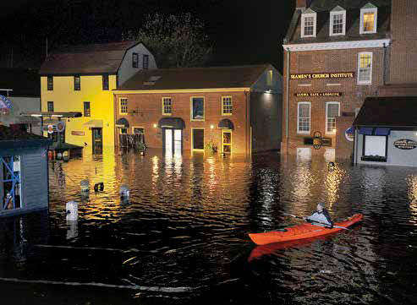
Identified, assessed, and addressed vulnerabilities of small businesses in Rhode Island.
Developed Risk Reduction Guides with practical information to help small businesses become more resilient.
Developed recommendations for municipal and state governments to support business resilience.
Risk Reduction for Small Business Resiliency Project
Notes:
Experience shows that 40% of small businesses affected by disaster never reopen; another 25% that do reopen fail. To reduce this impact to our businesses and our communities, the Risk Reduction for Small Business Resilience in RI project developed tools to support small businesses (less than 50 employees) to better prepare for extreme weather events.

Slide 13
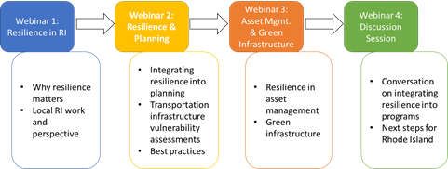
Transportation Planning & Natural Hazard
Resilience Seminar Series
In cooperation with FHWA
11/13/20
11/20/20
12/11/20
12/11/20
Notes:
RI Division of Statewide Planning, in coordination with the Federal Highway Administration, held a virtual training series for Rhode Island stakeholders beginning on November 13th. This seminar series helped planners to incorporate resilience into the transportation planning process, from a local, regional and statewide level to reduce the risks to Rhode Islanders and the economy from infrastructure disruption. Ten AICP Credits were available to attendees. This training was offered as a series of modules on 4 Friday afternoons starting on November 13th and continuing until December 11th.

Slide 14
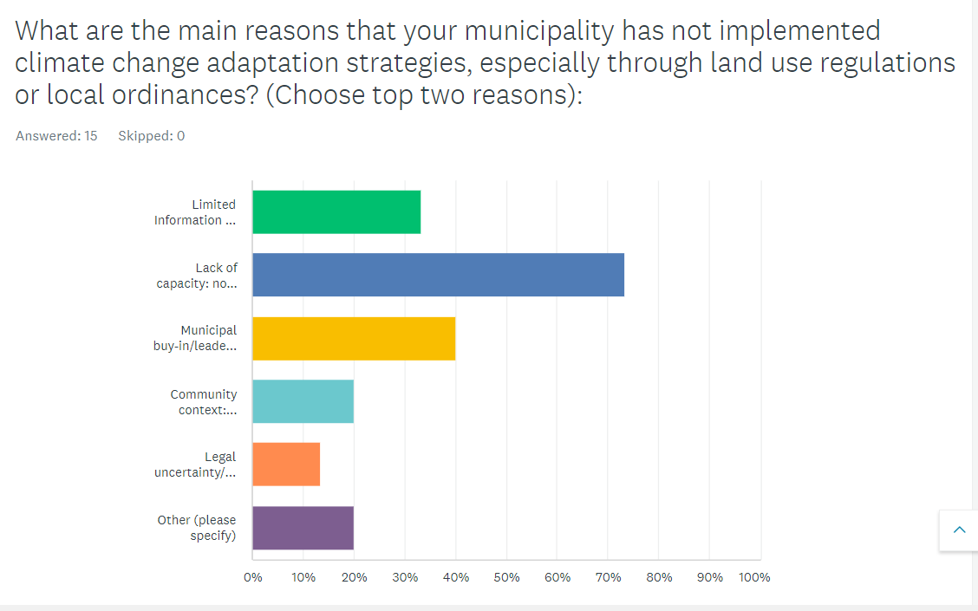
Barriers to Climate Adaptation Survey
Notes:
RIDSP reached out to municipal planners to determine the barriers that they face in implementing climate adaptation strategies. Here is a snapshot of their responses.

Slide 15
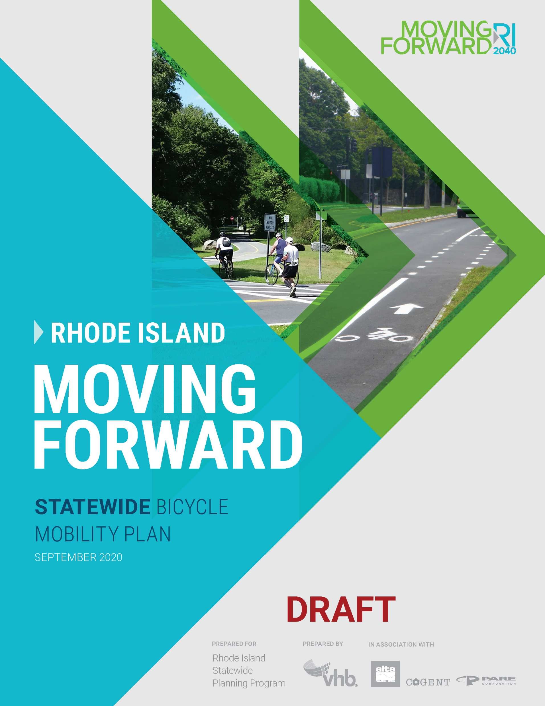
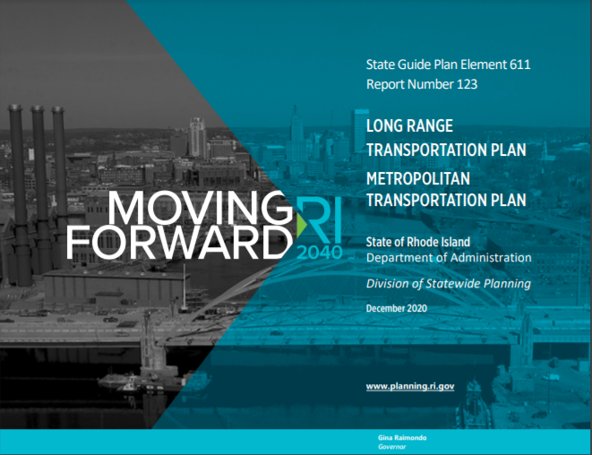
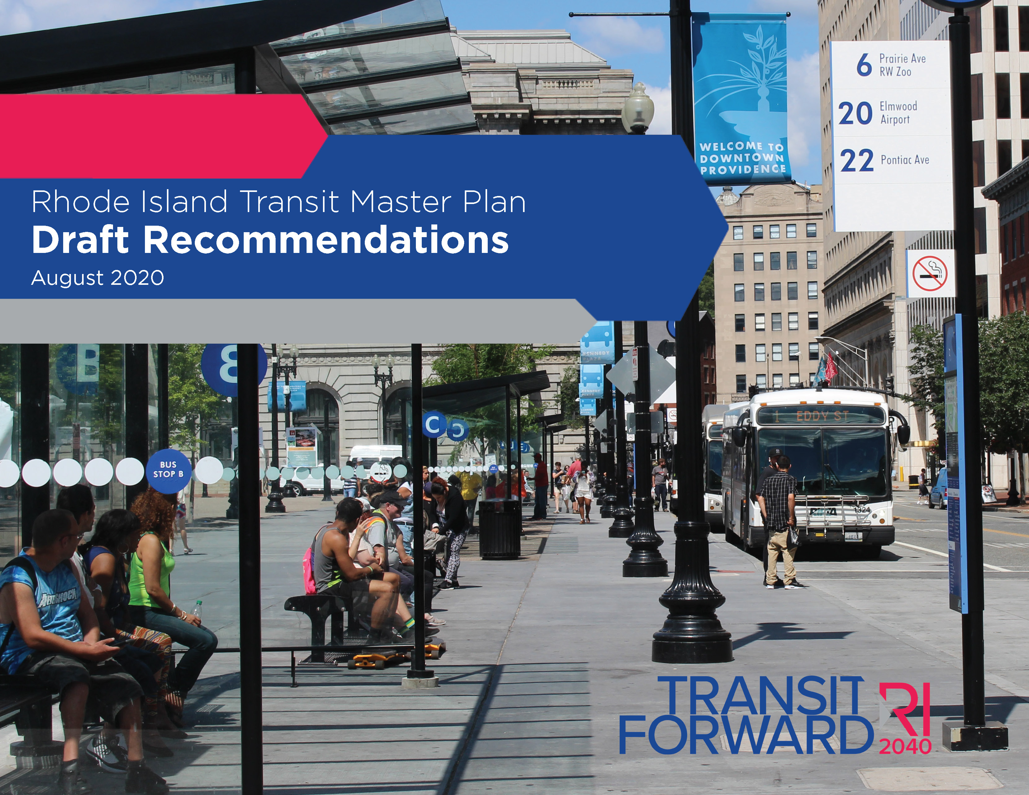
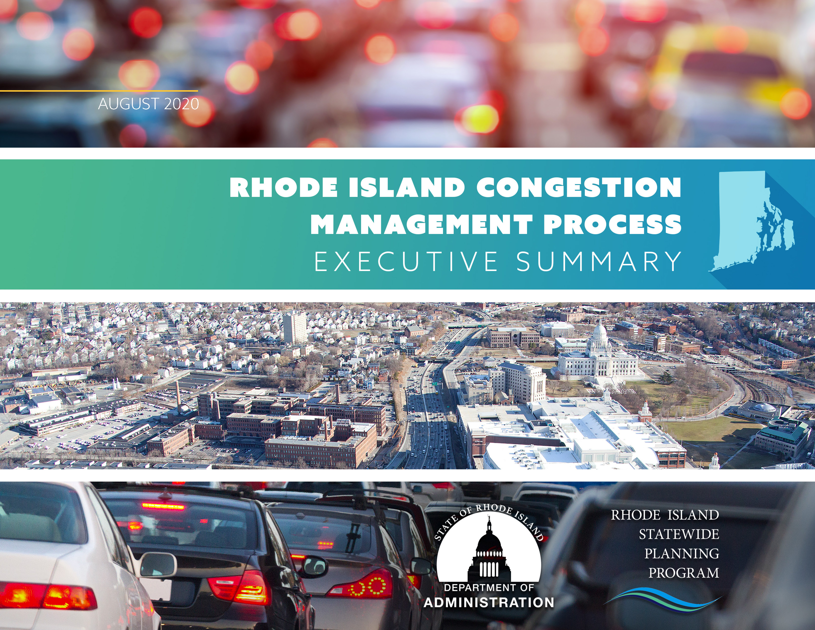
Long Range Plans
Completed

Slide 16


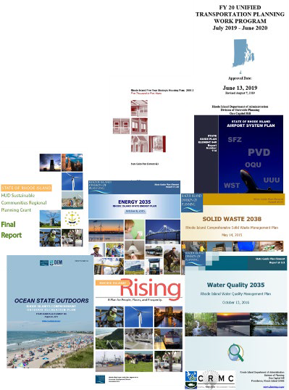
State Guide Plan
42-11-10 – State Guide Plan Law
Series of topical plans used to centralize long-range goals, policies, plans, and implementation activities. for the State
.
The State Planning Council is responsible for approval of elements of the State Guide Plan.
Currently there are 17 Elements of State Guide Plan
Notes:
Presenter
2021-09-28 17:32:50
--------------------------------------------
The State Guide Plan provides standards by which specific projects or proposals are evaluated for consistency with state goals, objectives, and policies. This review function is used in a variety of contexts. Some involve only state agencies while others involve the interaction of federal or local entities with the state. Items that are evaluated for consistency with the State Guide Plan include: Direct federal projects within the State
Proposals requesting federal funds
Applications for U.S. Army Corps of Engineers permits Environmental Impact Statements
Economic Development Corporation projects Projects before the Energy Facility Siting Board
Applications for various loans, grants, or other funding coming from state financing Property uses proposed before the State Properties Committee
The Comprehensive Planning and Land Use Regulation Act requires every Rhode Island city and town to adopt a Comprehensive Plan. Each local Comprehensive Plan is required to be consistent with the State Guide Plan. The State Guide Plan serves both as a guidance document to municipalities as they formulate their individual Comprehensive Plans and subsequently as one of the standards by which the State reviews the local plans.

Slide 17

Transportation
Solid Waste
Management
Energy
Water Resources
Economic Development
Historical Preservation
and Cultural Heritage
Housing
Recreation &
Open Space
Land Use
Natural Resources
Equity
Climate Change & Resiliency

Slide 18
What is the State Guide Plan?
The SGP provides a degree of continuity and permanent policy direction for the State’s future development.
The SPC is responsible for approval of all elements of the SGP, which has four primary functions:
  It sets long-range goals and policy positions (generally twenty years);
  It provides a means to evaluate and coordinate projects or proposals of State importance;
  It sets standards for comprehensive community plans; and
  It serves as a source of information on various topics of statewide importance.

Slide 19
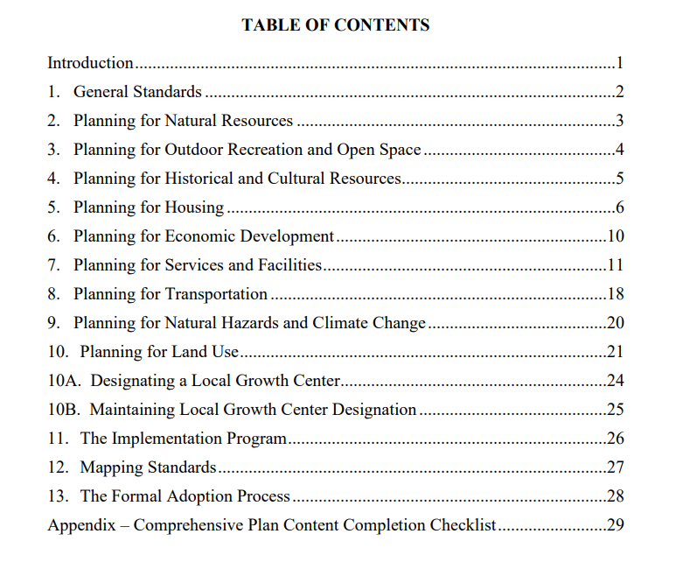
How Do We Review Local Community Comprehensive Plans?

Slide 20



Local Comprehensive Plans
26 fully-approved
11 expired
2 denied
- In 2011 revisions were made to the Rhode Island Comprehensive Planning and Land Use Regulations Act. A major change was that State approvals were extended from 5 years to 10 years. Also added was a new requirement for an implementation report.
- Ensures municipalities are assessing progress toward achieving actions identified in their implementation program
- Municipalities are now required to submit an; “Informational report on the status of the comprehensive plan implementation program with the Division of Planning not more than five (5) years from the date of municipal approval” (§ 45-22.2-12).

Slide 21

Why a Status Report?
This requirement is meant to help, not hinder municipal planners
Keep Comprehensive Plans “Alive”
Track Implementation to see where communities have successes and where they struggle
Feedback will shape the types of technical assistance provided by Statewide Planning
Help focus local planning efforts and continue to maintain the importance of Comprehensive Plan consistency in all development reviews

Slide 22


Are Communities Penalized If They Don’t Have An Approved Comp Plan or Exceed the 5 Year Reporting Deadline ?
Although the required by law, there is no specific penalty for failure to comply.
Per RIGL 45-22.2-13 “(h) Upon approval by the chief or superior court, the municipality is eligible for all benefits and incentives conditioned on an approved comprehensive plan pursuant to this chapter, and the municipality is allowed to submit the approved comprehensive plan or relevant section thereof to any state agency which requires the submission of a plan as part of its requirements, and the plan or relevant section thereof shall satisfy that requirement.”

Slide 23



Federal Government
Delegates power via constitution and laws
Where does the power to protect the public interest come from?
State of Rhode Island Enabling Legislation
Comprehensive Planning Act
  Zoning Enabling Act
Land Development & Subdivision Review Act
  Others
Municipality
City/town council or mayor appoints board and commission members Legal Authority given to public bodies provided via State law, municipal charters and or local ordinances
Public Body
Protects the public interest through land use planning and administration of land use regulations and ordinances.
Notes:
Presenter
2021-09-28 17:32:51
--------------------------------------------
Town / City Council
Your local council -- elected by the voters –- enacts and amends the comprehensive plan and zoning ordinance. They also approve any special overlay districts or master plans. They hear recommendations from planning and zoning boards to make decisions. Planning Board
Your local planning board, volunteers from the community appointed by the Council, enacts land development and subdivision regulations, reviews site plans for permitted uses, and approves applications for subdivisions and land development projects.
The planning board also prepares updates to the comprehensive plan and initiates or reviews proposed amendments to the zoning ordinance. The board sends its recommendations to the Council, who can enact the recommendations or make changes following a public hearing. Zoning Board
Your local zoning board, also volunteers appointed by the Council, grants relief from requirements in the zoning ordinance when a property owner cannot comply with the ordinance because of the physical characteristics of the property. The zoning board also approves special use permits and hears appeals from decisions by the zoning enforcement officer. The zoning board does not enforce the zoning ordinance or send violation notices.

Slide 24
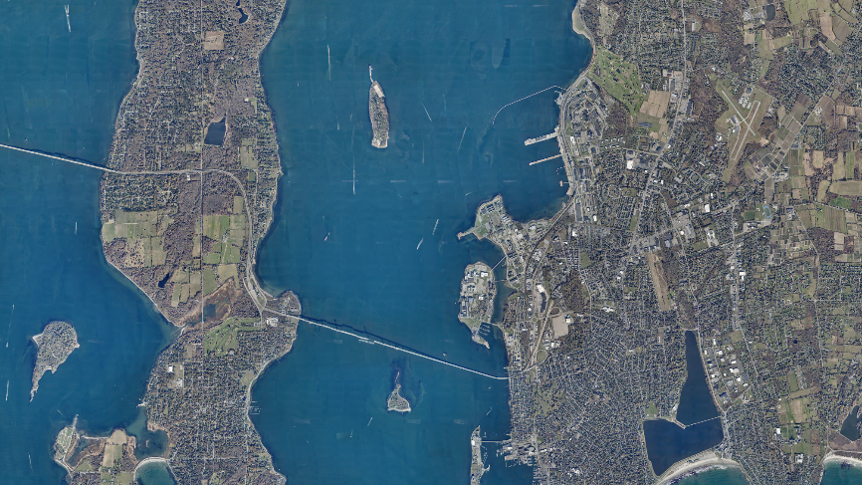
Land Use 2025
Notes:
Good morning, my name is Vin Flood and I’m a Data Analyst within Division of Statewide Planning Data Center…I also want to introduce Christina Delage Baza another Data Analyst in our section, she has also been the Secretary of the RIGIS Exec. Comm. for as long as I can remember…and can also help answer any questions you may have
Before we get started I just wanted to quickly give a description of what a GIS is…

Slide 25

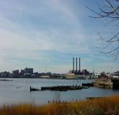
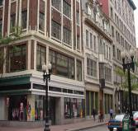

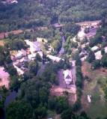










Land Use 2025
Where are we, and where are we going?
Where do we want to be in 2025?
Issues to be concerned while getting there?
How do we get there?
What must be done to achieve vision?

Slide 26
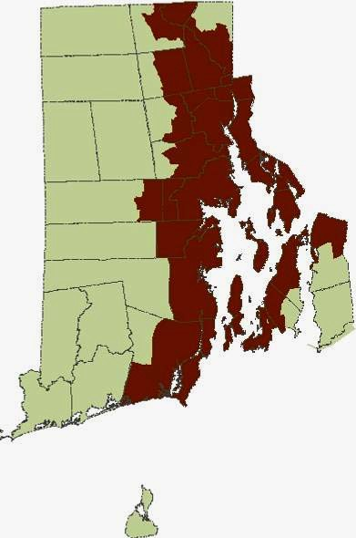















Where are we?
80%+ Rhode Islanders still live in urbanized areas along the Bay & major rivers
In recent decades, growth has been both outward from this core; and coming into the state from neighboring states
More significant is the way we are growing and impacting on the RI landscape
R.I. Statewide Planning Program 05-12-06

Slide 27
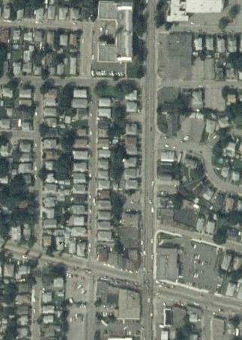














Changes in Land Use
We Used to Live and Work in Compact Communities….
Small house lots
Mix of housing types
Interconnected street network to disperse traffic
Mixed uses; Housing, shopping and civic functions
R.I. Statewide Planning Program 1-06

Slide 28
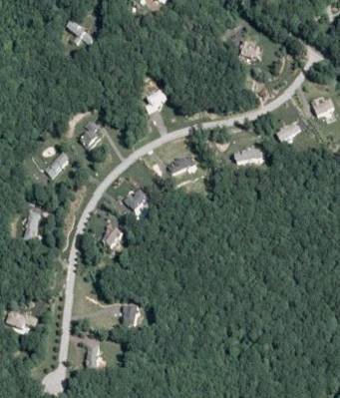









What is Different Now?
Lots have larger footprints than traditional development
One dominant housing type (single family)
Single-use areas – separation of industrial, business & civic uses
Roads have few interconnections
Traffic concentrated on collectors and arterials
R.I. Statewide Planning Program 05-12-06

Slide 29
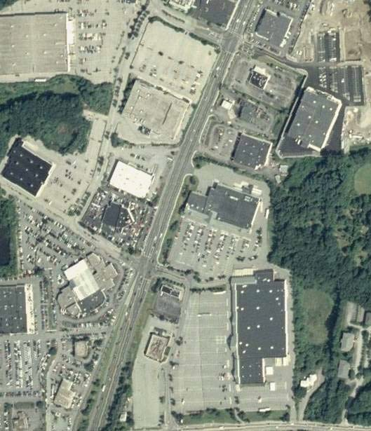







Results
Developed land increasing 9 times faster than population
Population and jobs moving away From Urban Core
Unsustainable sprawl
~ 30% of state’s land currently developed
R.I. Statewide Planning Program 05-12-06

Slide 30




It took 330 years to develop the first 20% of our land, but just over 25
years to develop the next 10%.
R.I. Statewide Planning Program 05-12-06

Slide 31








Total New Developed Land by 2025
109,000 acres or 16% of state area
R.I. Statewide Planning Program 05-12-06

Slide 32
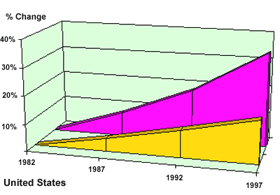





Population & Land Development Rates in the United States
Population Change Development
Changes in Population & Newly Developed Land from 1982-1997
R.I. Statewide Planning Program 05-12-06

Slide 33
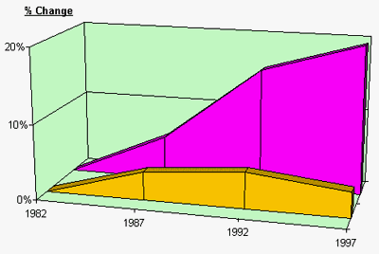












Rhode Island Population & Land Development Rates
Population Change Development
Changes from 1982-1997
R.I. Statewide Planning Program 05-12-06

Slide 34
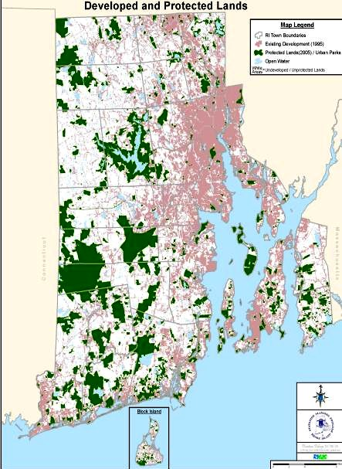
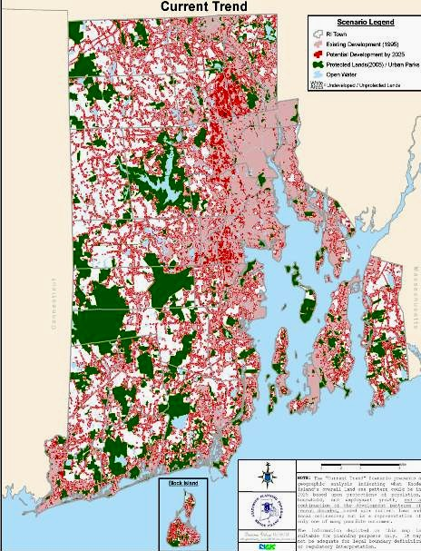
Where are we going?
1995
2025?

Slide 35


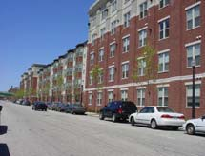








Primary Goals
A Sustainable Rhode Island
Greenspace & Greenways
Excellence in Community Design First Class Infrastructure
R.I. Statewide Planning Program 05-12-06

Slide 36
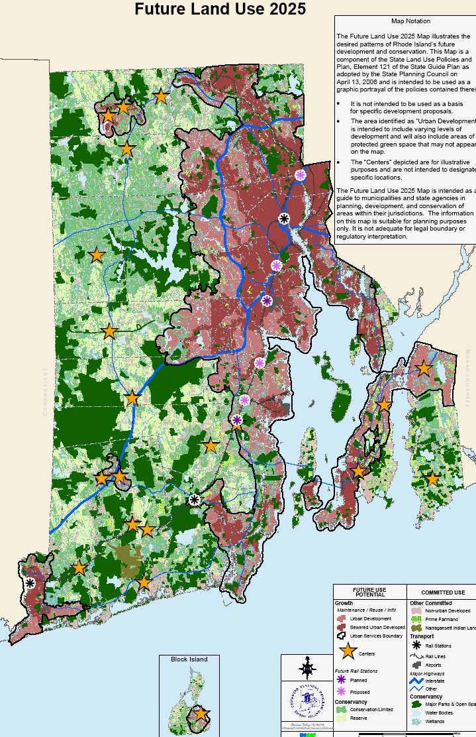






What Does This Look Like?
Concentrates growth in:
  Urban Service Boundary
  Growth Centers
Maximizes investment in existing infrastructure
Promotes more efficient development:
  Infill
  Rehabilitation
  Higher Densities
Maintains Green and Open Space
R.I. Statewide Planning Program 05-12-06

Slide 37







Not all new ideas
Relate state land use policies to anticipated population growth to enhance the distinction between urban and rural places.
Use open space to control and shape urban growth.
Promote the use of higher residential densities and smaller lot frontages in urban and suburban areas, and town centers, where public water and sewer service is present or planned.
Promote low overall density where public service are not planned. Promote the clustering of development in these areas.
R.I. Statewide Planning Program 05-12-06

Slide 38






What Needs To Be Done?
State Investment Strategy that focuses support for
growth- inducing development investment within the Urban Services Boundary and in Growth Centers
R.I. Statewide Planning Program 05-12-06

Slide 39





State Investments
Discretionary public infrastructure investments which can help shape Smart growth:
Community Development – CDBG
Housing – Neighborhood Opportunities Program
Economic Development – CEDS
Land Preservation – Open Space grants, Bikeways
Drinking Water – Clean Water SRF
Wastewater – RI Clean Water Finance SRF
Transportation – Transportation Enhancement Program, CMAQ
Education – School Housing Aid
R.I. Statewide Planning Program 05-12-06

Slide 40

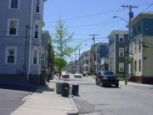
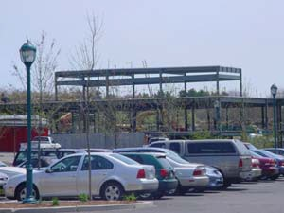

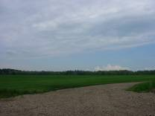
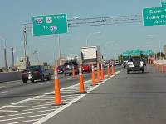







What Are Some Of The Other Issues?
Affordable Housing
Economic Development
Resource Constraints
  Water
  Sewer
Open Space Protection
Transportation
R.I. Statewide Planning Program 05-12-06

Slide 41
A plan without data is a guess;
A plan isn't just a list of hopes and wishes, it develops measurable, achievable criteria.

Slide 42
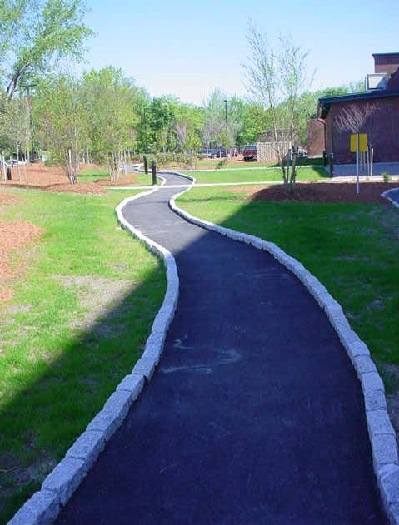








The Challenge Ahead
How do we measure
success?
Or lack of ?
R.I. Statewide Planning Program 05-12-06

Slide 43








Land Use Performance Measures
To be measured within the Urban Services Boundary:
$$ Investments
# of Housing Units permitted
Amount of Commercial/industrial square footage constructed
Density of housing units
# of current Comprehensive Plans
# of Towns with full-time planning staff
To be measured outside of Urban Services Boundary
# of lost acres of farmland
# of Growth Centers
# of current Comprehensive Plans
# of Towns with full-time planning staff
R.I. Statewide Planning Program 05-12-06

Slide 44
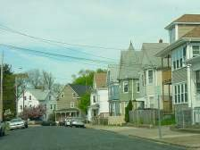
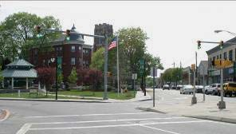
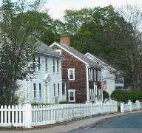
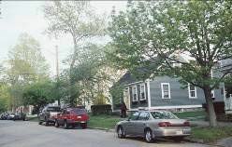
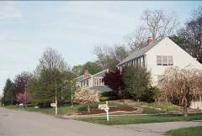










Tools to Promote Compact Development
Community Comprehensive Plans Form based Codes
Transit Oriented Development Projects of Regional Significance Transfer of Development Rights Permit Allocation Systems Historic Tax Credits
R.I. Statewide Planning Program 05-12-06

Slide 45


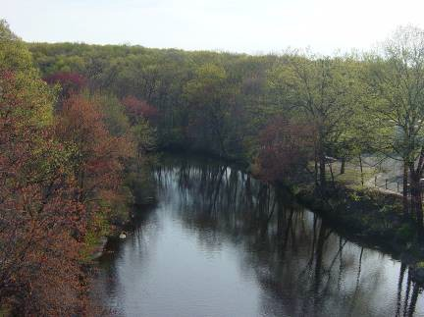
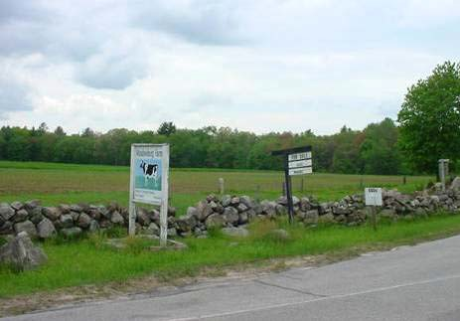







Tools to Promote Preservation
Comprehensive Plans
Land Acquisition Farmland Zoning Historic Overlay Zoning
Buying Development Rights Cluster Development Conservation Development

Slide 46
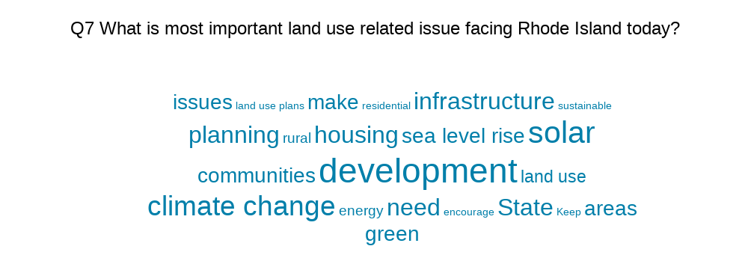
Planning Board Survey Response

Slide 47
This map shows the percent change in total population from the 2010 Census to the 2020 Census at the municipality level.
Top 5 in terms of population growth were New Shoreham, Central Falls, East Greenwich, Cumberland and Providence
Strong growth in northeast urban core cities
Narragansett, Foster and Bristol lost population.

Slide 48
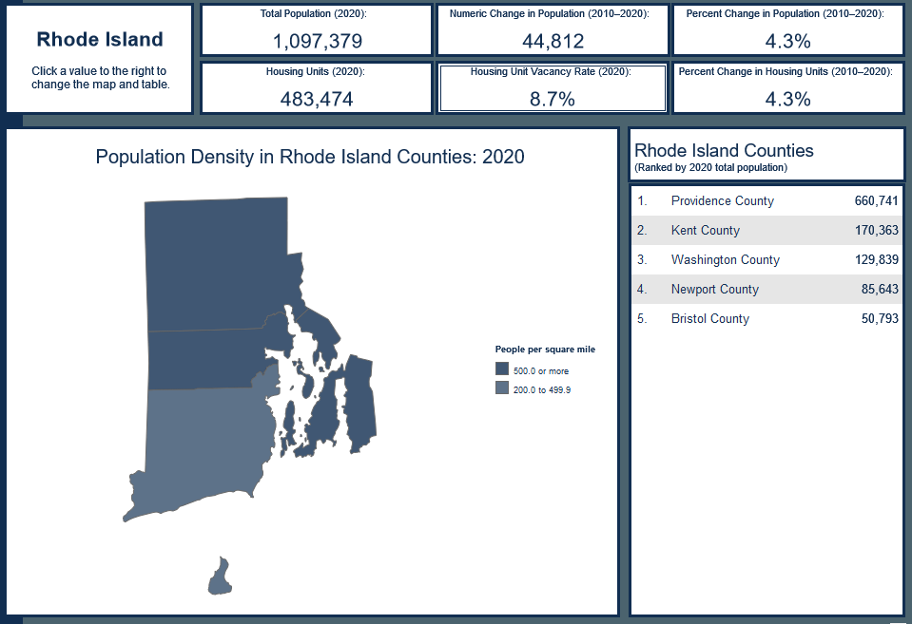
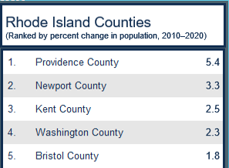
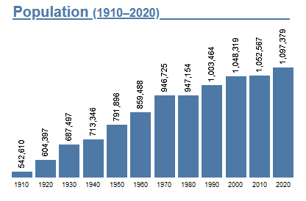
Rhode Island’s Population Grew 4.3% Last Decade

Slide 49
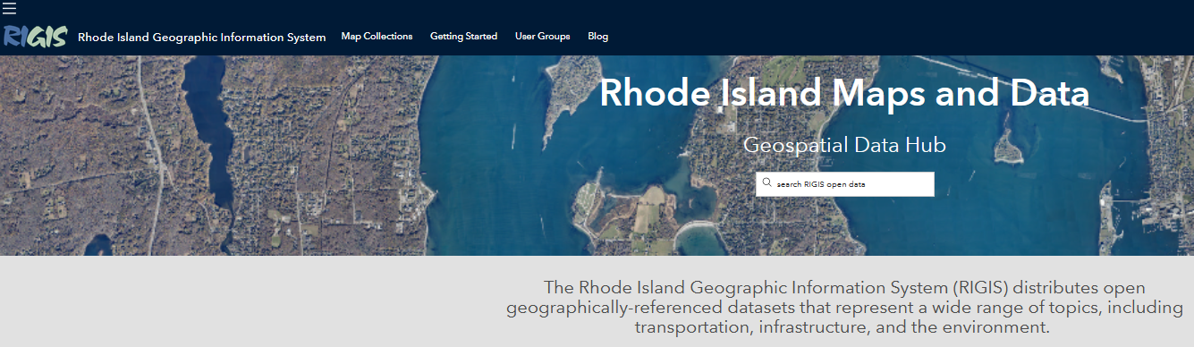
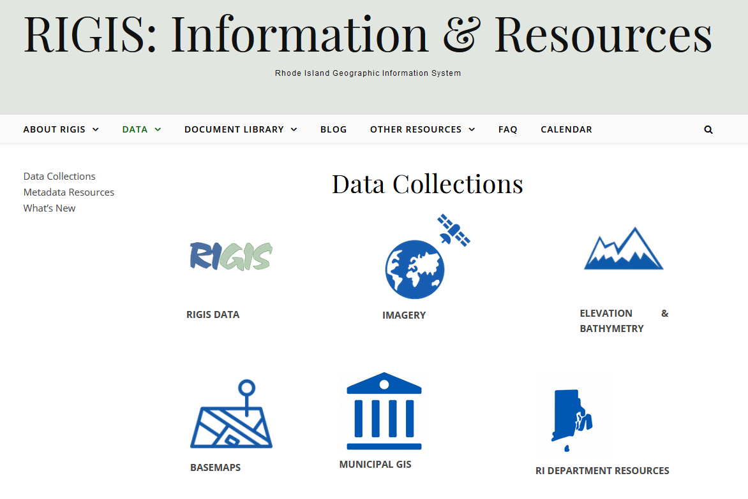
RIGIS Online Database
Other Data Resources
Free access and downloads
Several Hundred Spatial Datasets, Categories
Many Contributors
Managed by URI Geospatial Extension Specialists
Aerial Photography – RIDSP, RIDOT, RIDEM...
Notes:
Through the RIGIS Website…RIGIS is able to provide free access to, and downloads of, hundreds of spatial datasets across several thematic categories.
The database is compiled from data submissions by many contributors across the state, including state agencies.
These data adhere to the RIGIS quality assurance and federal metadata standards, and are maintained by the data source providers.
The RIGIS database and website is managed by the URI Geospatial Extension Specialists.

Slide 50
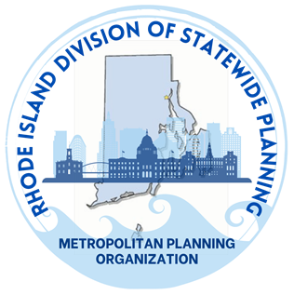

Thank You!
Questions?
Meredith.Brady@doa.ri.gov
(401) 368-7601 (cell)
Resources? http://www.planning.ri.gov or http://www.census.ri.gov
We’ve got reports and aerial photographs going back to the 1930s. We’ll be happy to walk you through our data tools or provide documents from our library.

